Slide 1
Recipe Discovery Project
Solving how to predict popular recipes for the Tasty Bites homepage

Slide 2
Background & Goals
The Product Management team manually selects recipes to display on the homepage
A popular recipes can increase web traffic up to 40%
The recipe selection can be automatized
A data science solution to correctly predicting which recipes are going to lead to increased web traffic
Target: >80% success rate in predicting a popular recipe

Slide 3
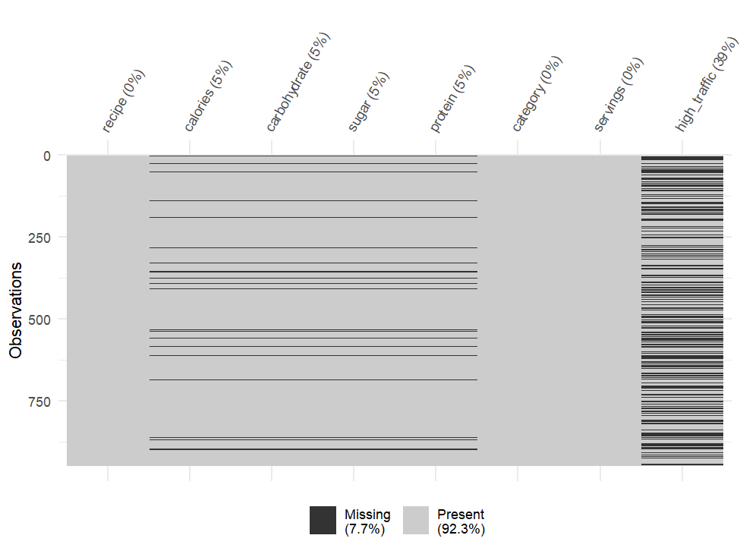
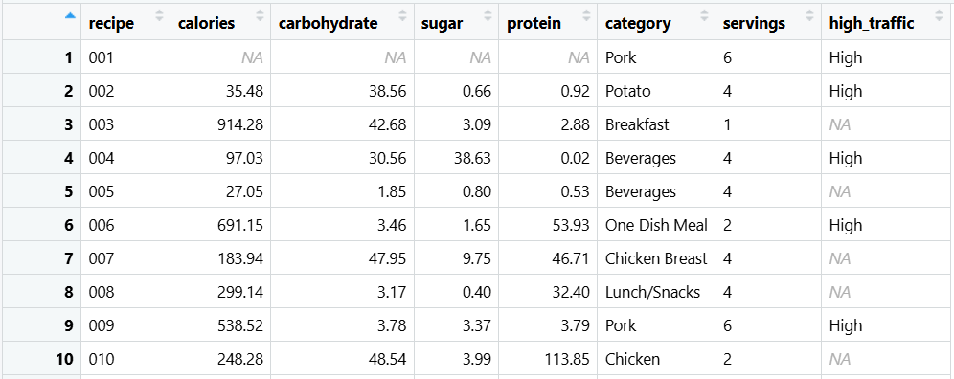
Data Information
Data set provided by the Product Management team
6 predictors, 1 outcome, and 1 ID variable
Validation revealed issues with extensive missing data in 5% of recordings, mixed alpha-numeric content, and inconsistent categories
Cleaning steps applied to obtain a more robust data set ready for analysis and modelling

Slide 4
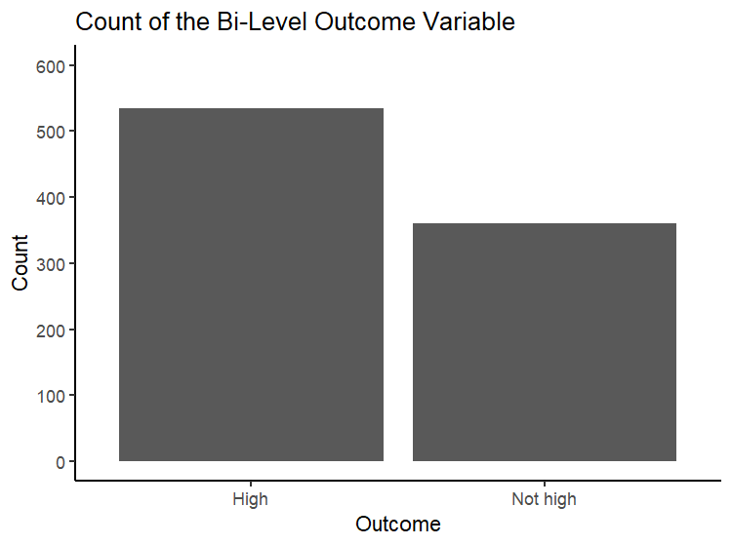
Exploratory Analysis
Most of the recipes provided in the data set ~ 60% are associated with high traffic

Slide 5
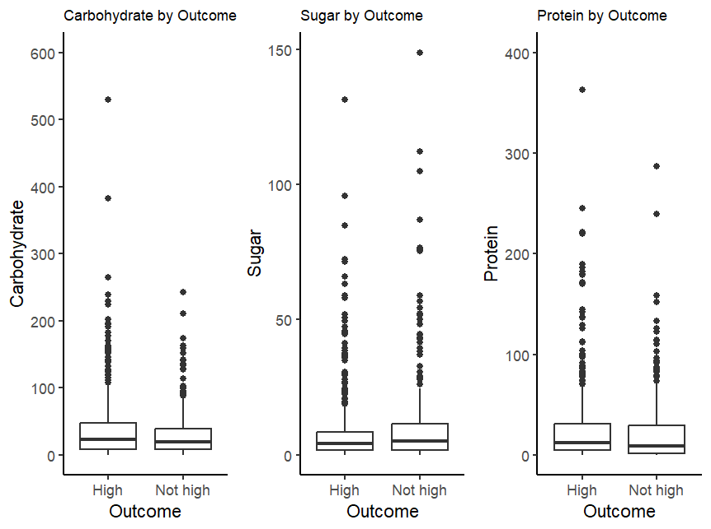
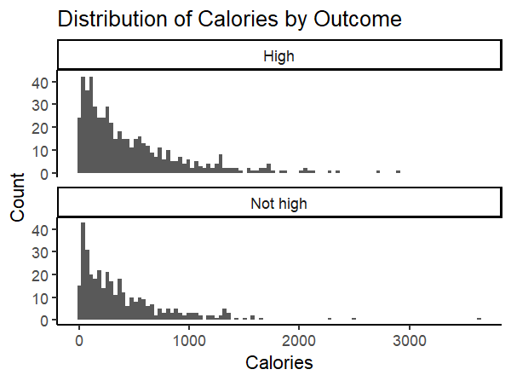
Exploratory Analysis
Numeric features do not appear to be correlated to a specific outcome

Slide 6
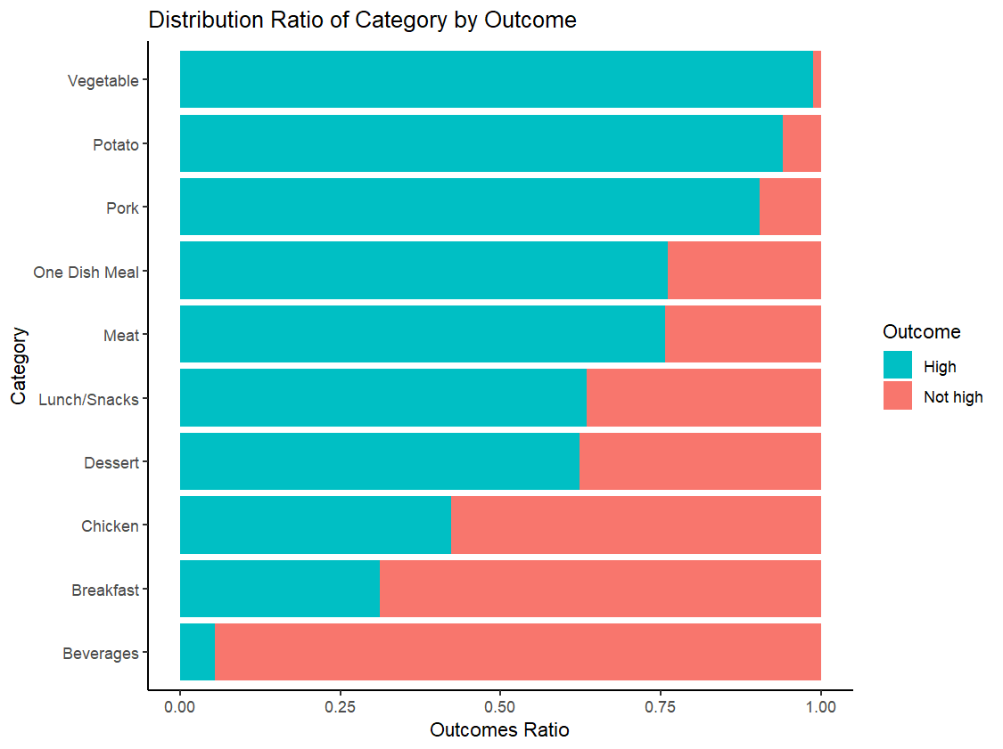
Exploratory Analysis
The recipe “category” appears to be a strong predictor of the traffic outcome

Slide 7
Model Selection
Classification Problem with Two Outcomes
Baseline model
Logistic Regression
simple
easy to interpret
takes advantage of the predictive value of the “category” variable
Comparison model
Random Forest
more complex
can help reveal hidden patterns in data for better predictions

Slide 8
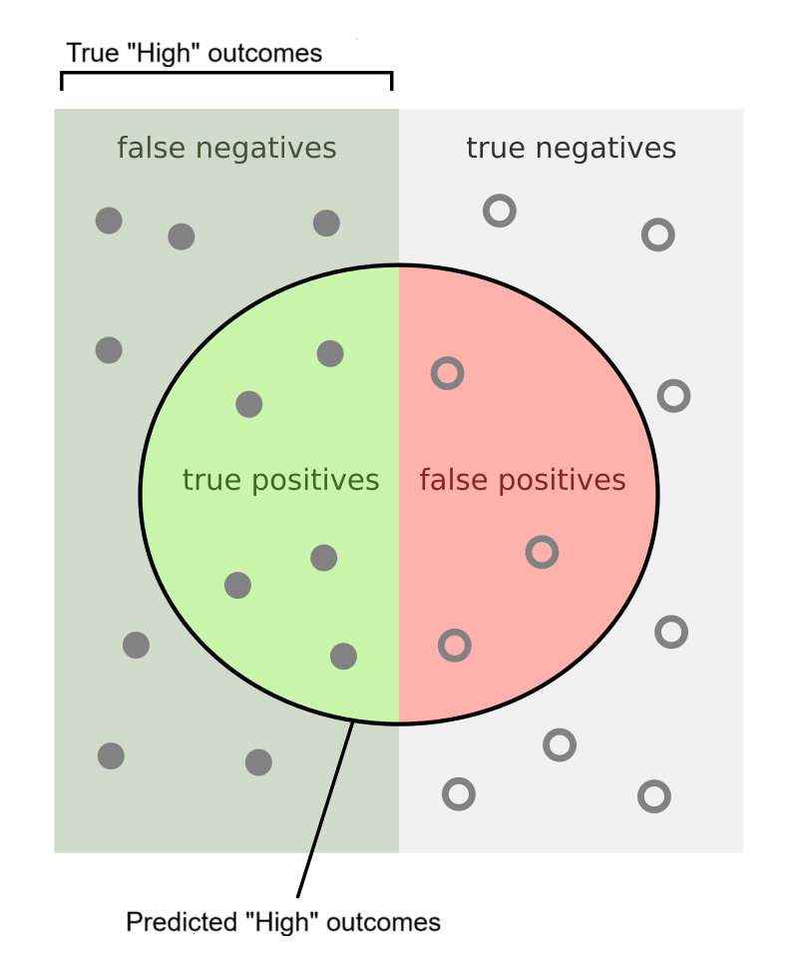
Metric Selection
Single Metric: Precision
Focuses specifically on the desired outcome of “High” traffic
Represents the proportion of true “High” outcomes out of the predicted “High” outcomes
Ranges 0 – 1
Target: >0.8
Source: By Walber - Own work, CC BY-SA 4.0, https://commons.wikimedia.org/w/index.php?curid=36926283

Slide 9
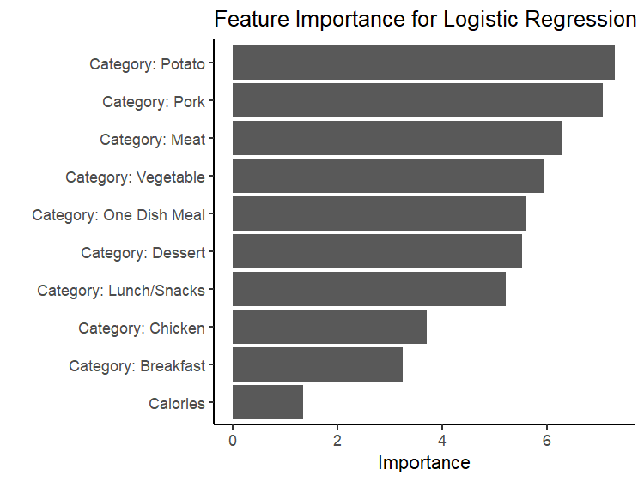
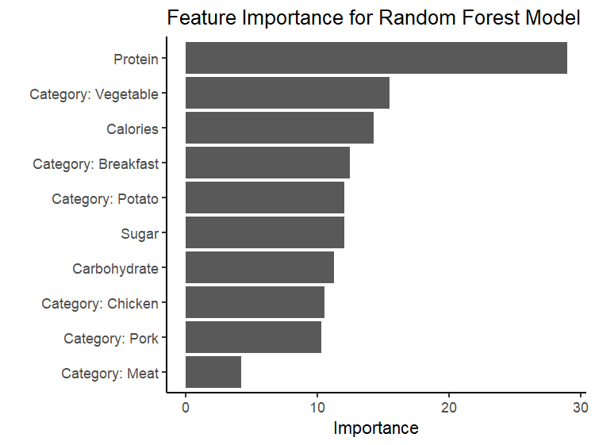
Model Performance
Model | Precision
Logistic Regression (Baseline) | 0.78
Random Forest (Comparison) | 0.77

Slide 10
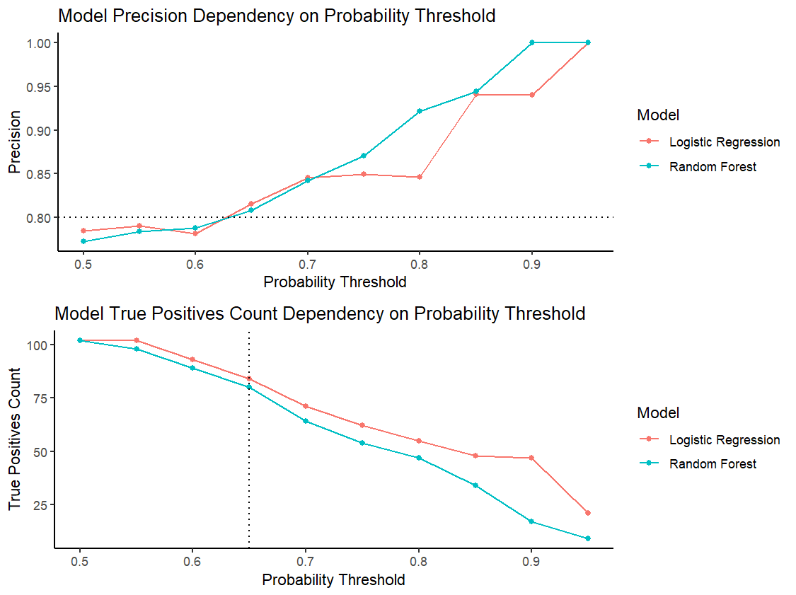
Model Performance
KPI: Precision & True Positives Count
Increasing the probability threshold >0.65 leads to precision over 0.8
Flexibility in changing the threshold to get desired precision while ensuring enough potentially popular recipes are identified

Slide 11
Recommendations
In the short-term, implement the Logistic Regression model with the current data pipeline.
Take advantage of flexibility in controlling precision performance by setting model parameters that fit our business objectives.
Monitor KPIs on a monthly basis to ensure stable and predictable performance.
In the long-term, improve data collection pipeline to avoid missing data, expand and improve categories, and expand the number of predictors (e.g. time-based variables, pictures presence, cost).
Implement A/B testing scenarios to discover additional variables that are associated with increased web traffic based on the homepage design.
Transition to more advanced prediction models to take advantage of hidden insights in expanded data sets.

